Slide 1

Workers Supervision for Construction Safety
PHAM, Trung Kien DO, Van Quyet

Slide 2
Agenda
Overview
Objectives
Datasets
Methodology
Experimental Result
Conclusion
References
Q&A

Slide 3
1 Overview

Slide 4
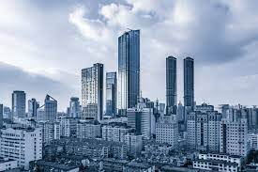
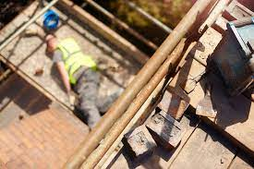

1. Overview
The construction industry grows significantly every year
# accidents in construction site also increases
Raise the need to enhance the safety. Our FOCUS: workers, wearing safety items
Notes:
There are several ways, like:
in term of non-human factor, make supporting tools and machine better to mitigate malfunction, which may cause accidents,
in term of human factor, equip workers with safety suits.
In this project, we focus on

Slide 5
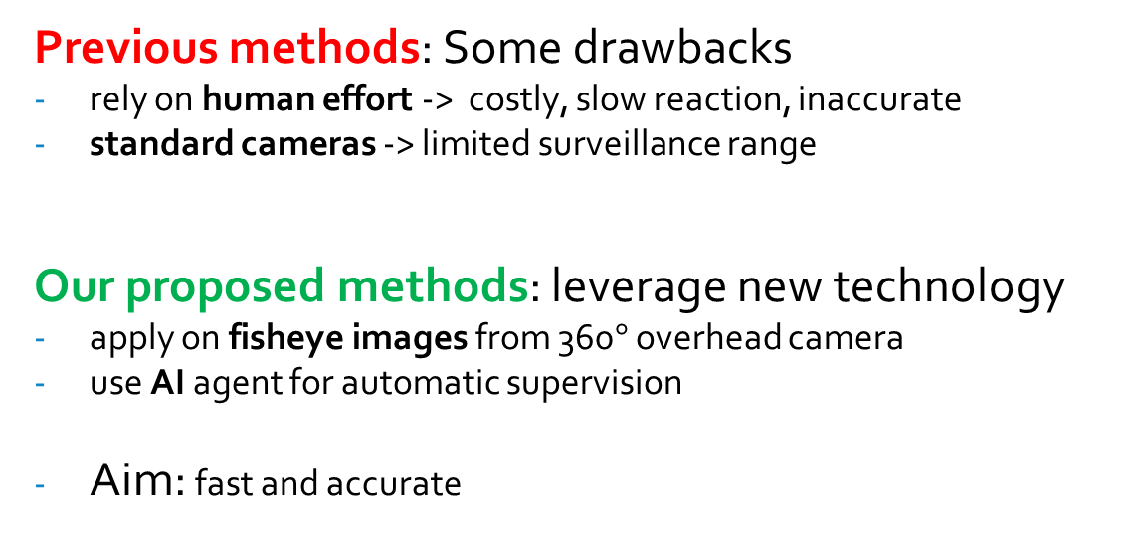
1. Overview
Previous methods: Some drawbacks
rely on human effort -> costly, slow reaction, inaccurate
standard cameras -> limited surveillance range
Our proposed methods: leverage new technology
apply on fisheye images from 360$°$ overhead camera
use AI agent for automatic supervision
Aim: fast and accurate
Notes:
Previous methods are costly, not suitable and scalable

Slide 6
2 Objective

Slide 7
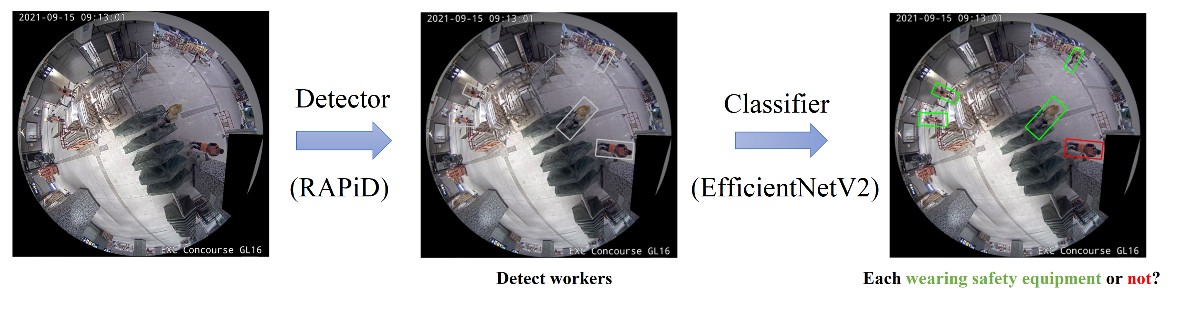
2. Objective
AI Model: Two major components:
a Multi-Person Detector to locate every worker inside input frames
a Binary Image Classifier to determine whether those workers are wearing all required types of safety equipment or not.
Notes:
Specifically, we use RAPiD as detector and EfficientNetV2 as classifier.
Expected pipeline is shown in the figure (interprete a bit about figures)
Classifier: 2 classes – wearing all and not wearing all
We will train those two models with task-oriented datasets, to give good performance

Slide 8
2. Objective
Evaluation and Expectation:
Detector (RAPiD):
use Average Precision (with IOU = 0.5) AP50 and F-measure
expected to reach performance as in original paper
Classifier (EfficientNetV2):
measure Accuracy, Precision and Recall
expected to reach 90% for each
Overall FPS: fast enough for instant reminder

Slide 9
3 Datasets

Slide 10
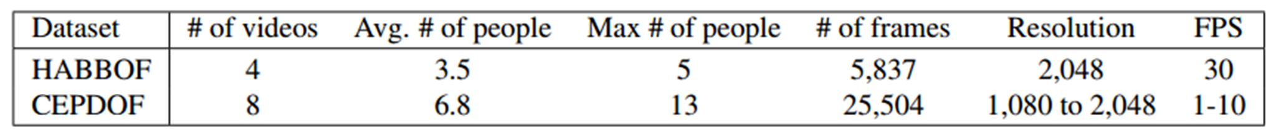
3. Datasets
for Detector:
HABBOF: Human-Aligned Bounding Boxes from Overhead Fisheye cameras
CEPDOF: Challenging Events for Person Detection from Overhead Fisheye image
Notes:
detectors: since workers can be regarded as human, we use datasets that are designated for human detection on fisheye images
here we introduce two prevalent datasets, captured by overhead fisheye cameras, and importantly annotated with rotated bounding boxes
This is some statistics about those datasets
CEPDOF contains many more frames and people, especially challenging scenerios such as crowed room, low-light condition, or various human body poses

Slide 11
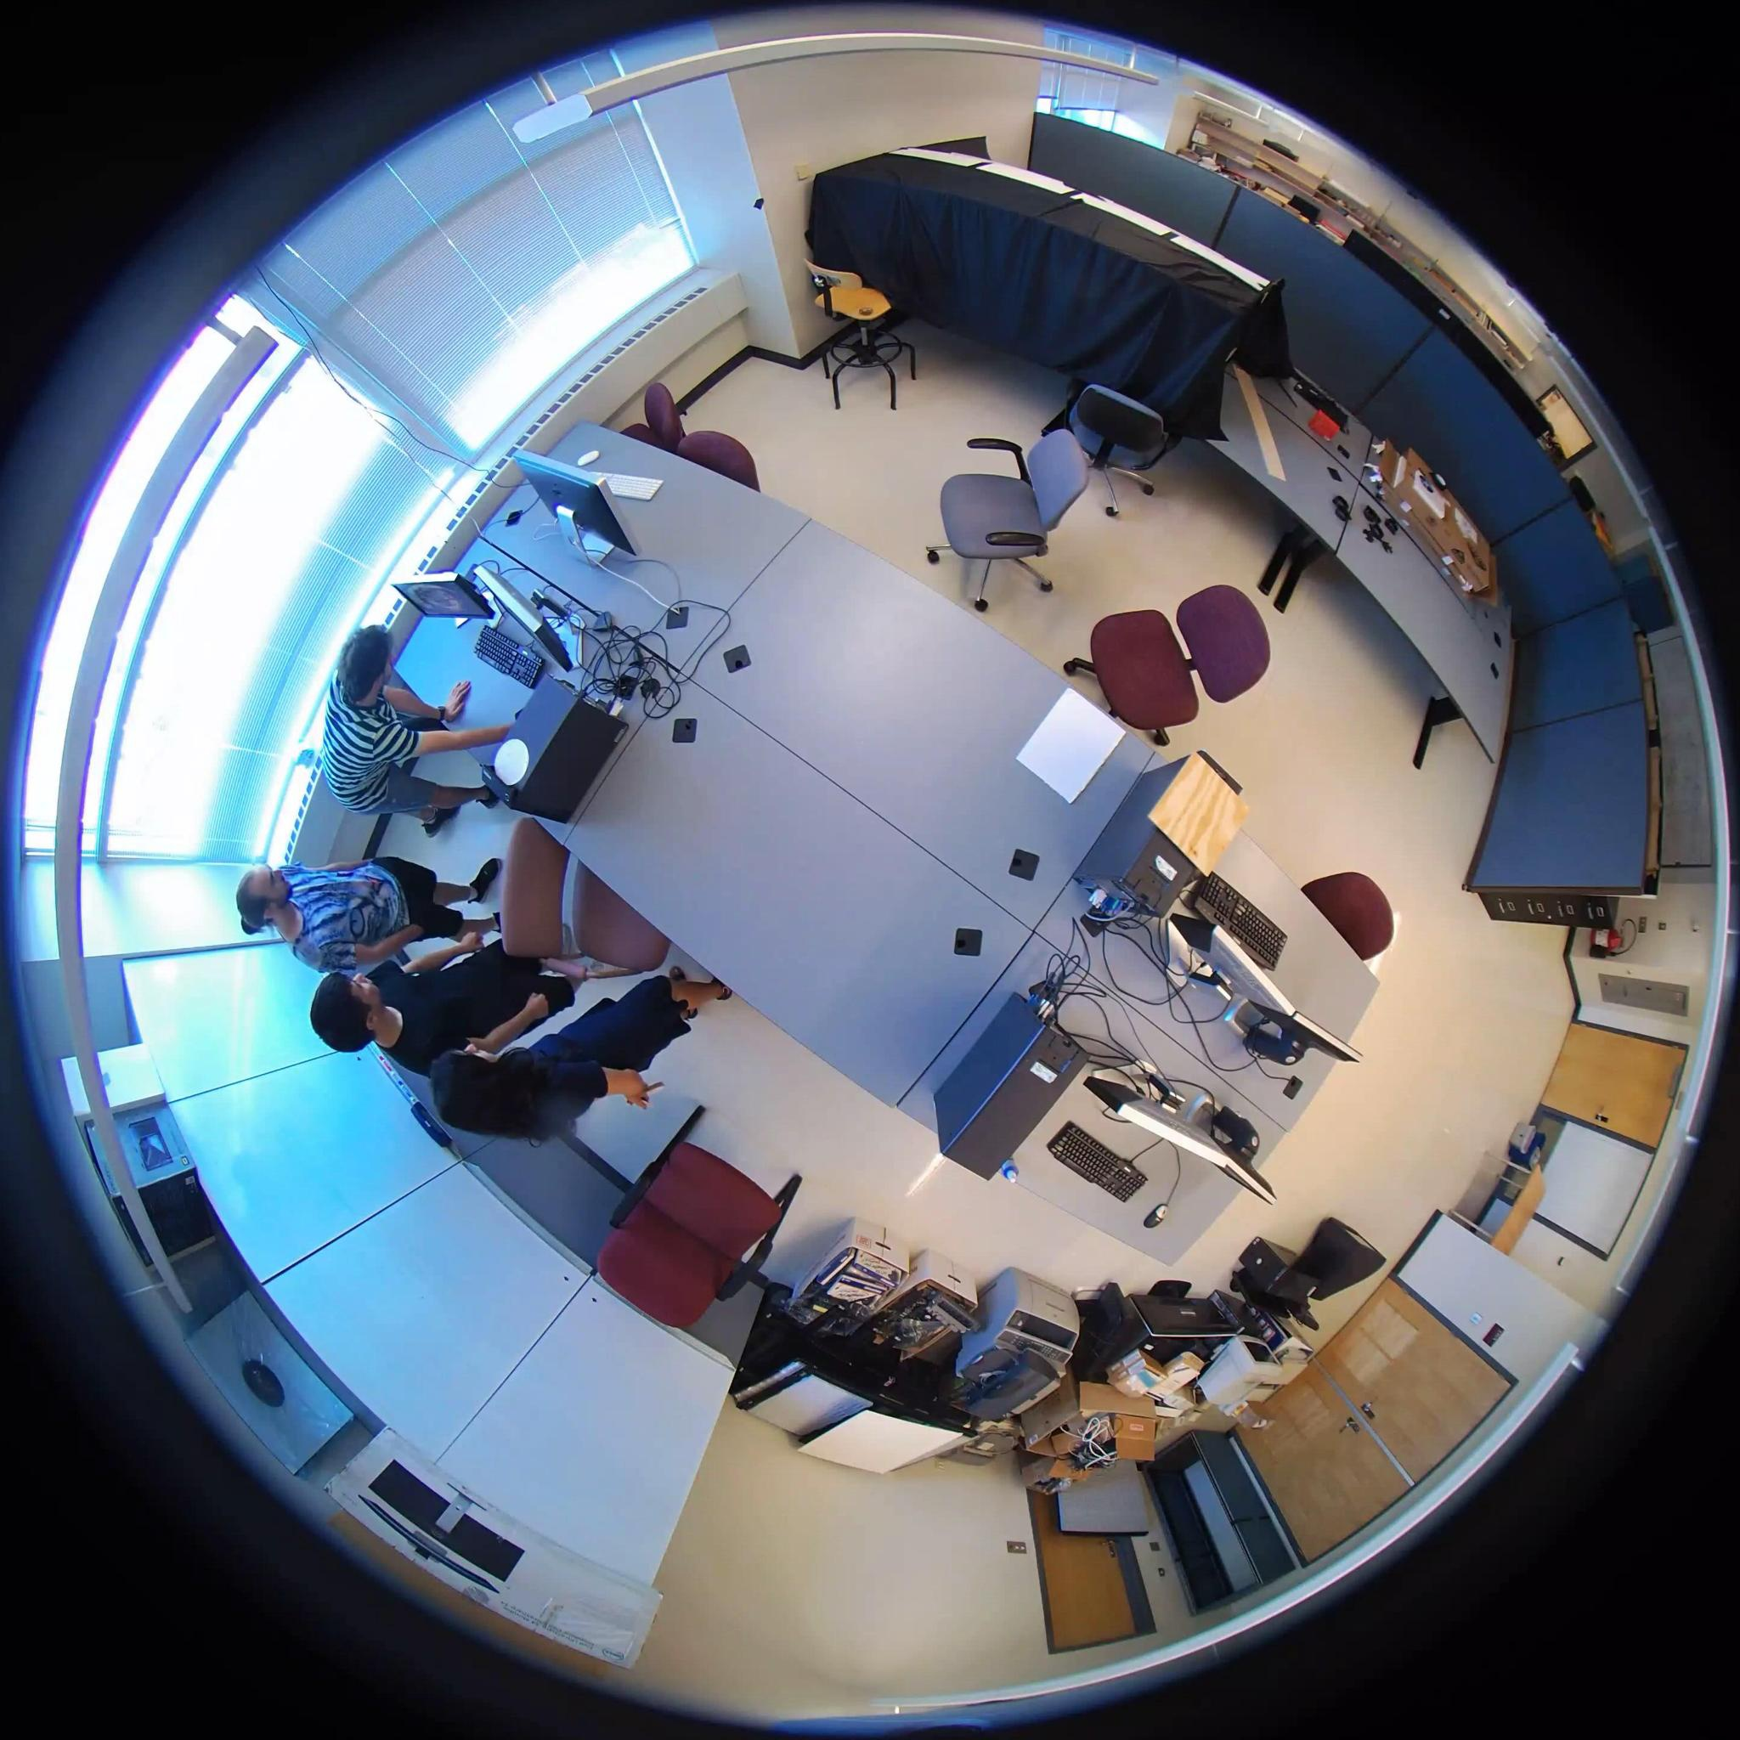
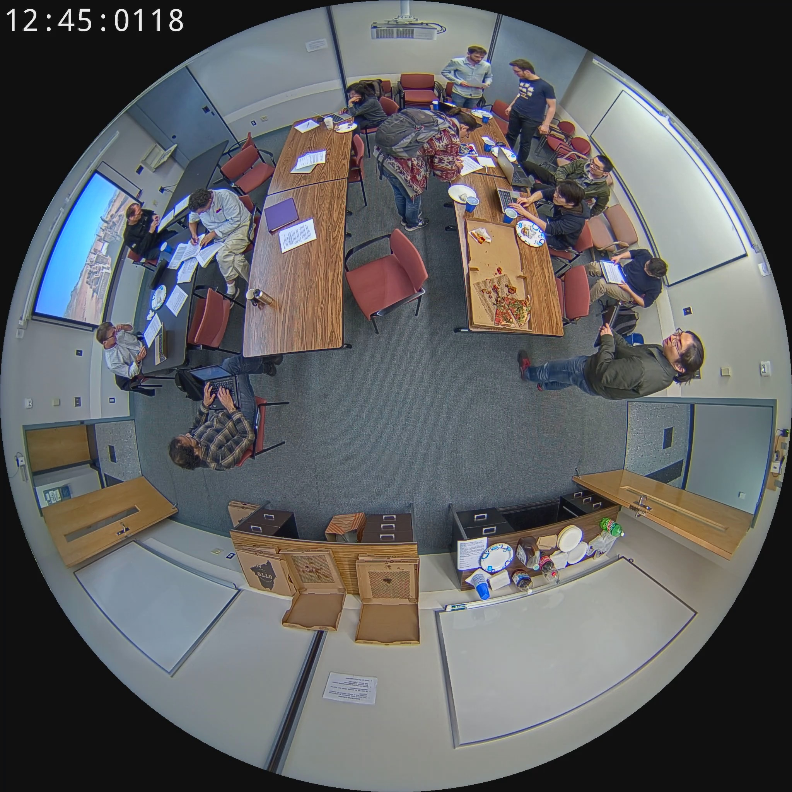
3. Datasets
for Detector: - image from HABBOF - image from CEPDOF
Notes:
more or less similar setting with fisheye images from construction site

Slide 12
3. Datasets
for Classifier:
scraping, crawling, and cropping from open sources on the internet like Google Images and Shutterstock
focus on safety helmet and safety jacket:
consist of: - 30000 images for safety helmet case (~50:50) - 30000 images for safety jacket case (~50:50)
Notes:
guarantee data balance

Slide 13
4 Methodology
Notes:
During the midterm presentation we have already gone through the details about our methodology that we used to construct the two components of our AI monitor. Therefore, this time I’ll only briefly re-mention this part.

Slide 14
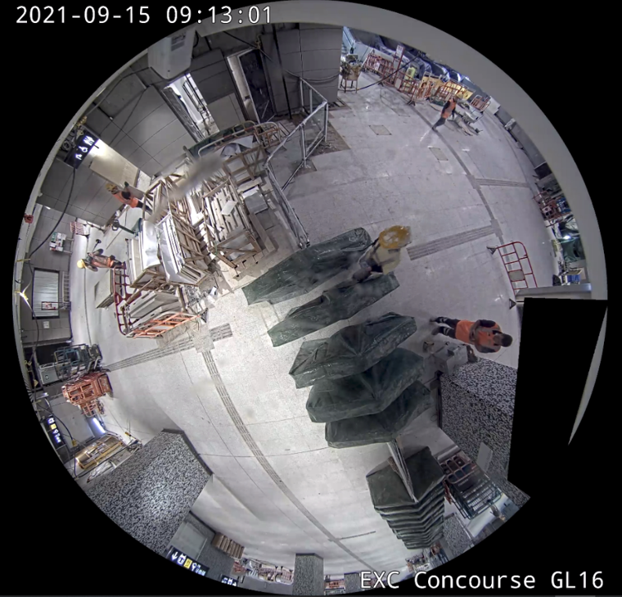
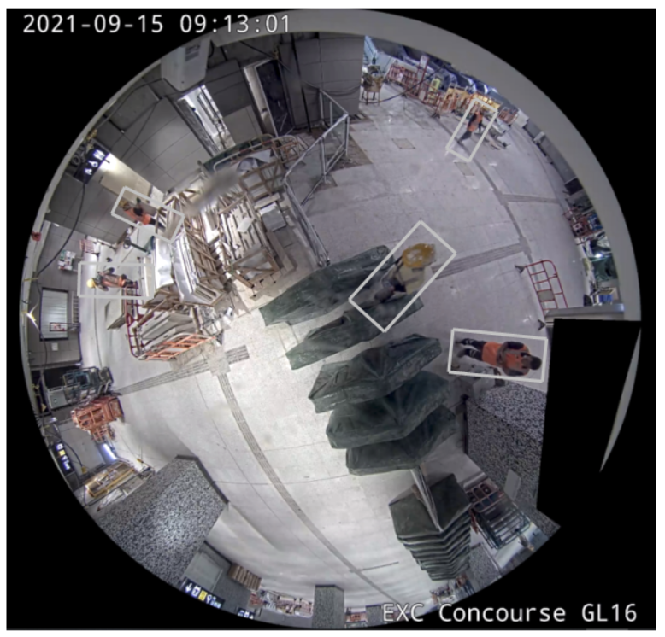
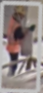
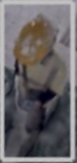
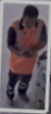
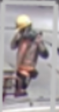
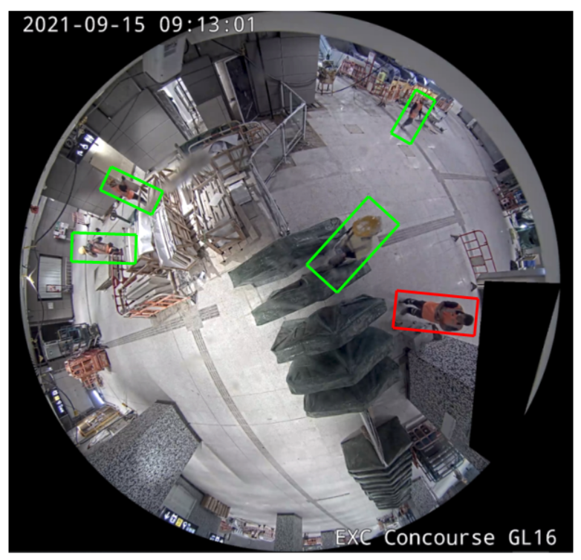
4.1 Pipeline
Binary Image Classifier
Multi-Person Detector
Notes:
As you already knew, our AI monitor consists of two component: one is a Multi-Person Detector and the other is Binary Image Classifier.

Slide 15
4.2 Multi-Person Detector
Binary Image Classifier
Multi-Person Detector
end-to-end model
arbitrarily-rotated bounding boxes
YOLO-based
RAPiD
Notes:
Our Multi-Person Detector is a replication of RAPiD model. RAPiD stands for Rotation-Aware People Detection, which is a YOLO-based end-to-end model that can perfectly predict arbitrary-rotated bounding boxes in overhead fisheye images.

Slide 16
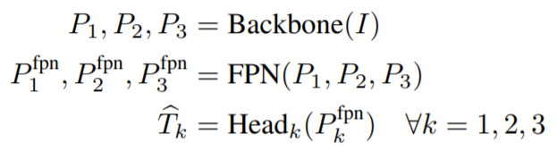
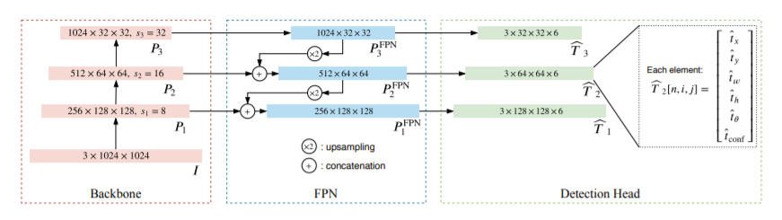
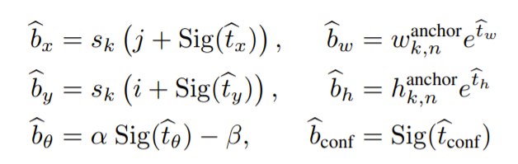
4.2.1 RAPiD Architecture
3
1
2
4
Notes:
It comprises of three components: a backbone network, also known as feature extractor, a Feature Pyramid Network, and a Detection Head, each has unique ability. 4 here does not mean the fourth component but the last step in feedforward pass that is used to make inference.

Slide 17
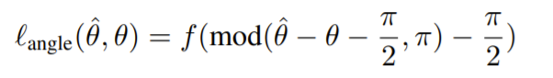
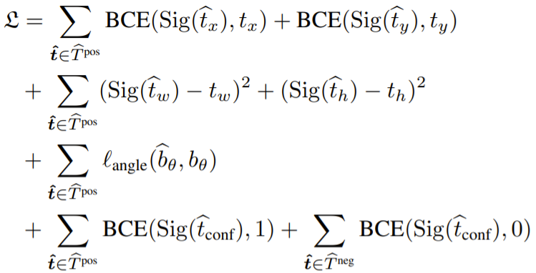
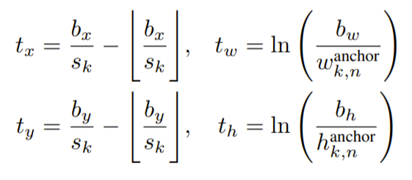
4.2.2 Why RAPiD ?
Continuous, periodic loss function for bounding-box angle
facilitates arbitrarily-oriented bounding boxes capable of handling a wide range of human-body poses
Notes:
The reason why we pick RAPiD to be our multi-person detector is because of its continuous periodic loss function for bbox that facilitates arbitrarily-oriented bounding boxes

Slide 18
4.3 Binary Image Classifier
Binary Image Classifier
Multi-Person Detector
new family of CNN for classification
Neural Architecture Search
Progressive Learning
EfficientNetV2
Notes:
The second component of our system is the binary image classifier in which we use, EfficientNetV2, a new family of Convolutional Neural Network for classification. It adopts Neural Architecture Search technique to construct its optimal lightweight architecture and Progressive Learning technique for fast training and inference.

Slide 19
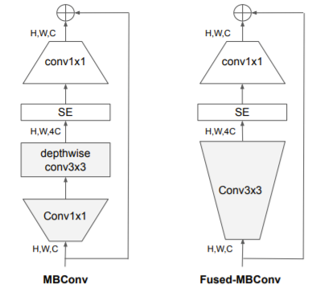
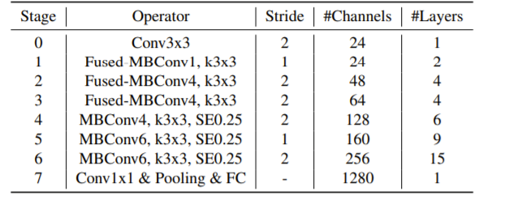
4.3.1 EfficientNetV2 Architecture
Notes:
In here we mentioned about its main component, MBConv and a fused version as well as introduced a full architecture for the small variant of it.

Slide 20
4.3.2 Why EfficientNetV2 ?
6.8x smaller in size
Much faster in terms of training and inference time
Maintain similar or even higher classification accuracy
Notes:
The reasons why we used it are, it’s smaller in size, faster in training and inference time, while can maintain competitive performance comparing to other CNN such as VGG or Resnet

Slide 21
5 Experimental Result

Slide 22
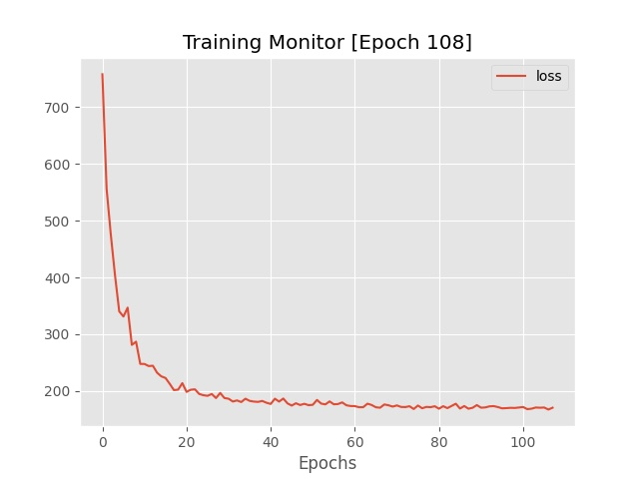
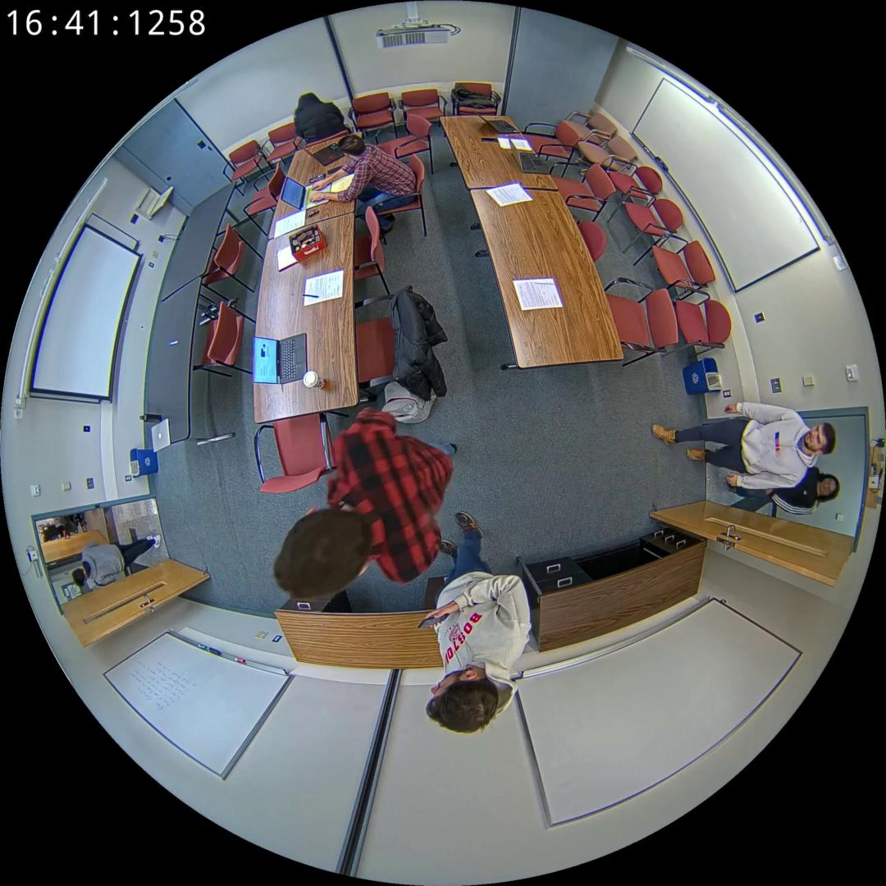
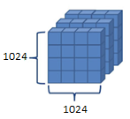

5.1.1 Multi-Person Detector - Preliminary
$$✓$$
RAPiD architecture implementation
Training and Fine-tuning process ~80%
Resize
Normalize
Convert to tensor
Datasets: CEPDOF and HABBOF
Images + Annotations
Preprocessing process
Normalized tensors of
1024x1024 spatial resolution
Loss decreases over epoch
learning rate = 1.e-4
momentum = 0.9
weight decay = 5.e-4
Configuration
batch size = 16
epoch ~ 100 ≈ 200000 iterations
At first glance, detector is correctly implemented and trained
SGD Optimizer
Training hyperparameters
Notes:
For the last presentation, we fed all 32000 frames from CEPDOF and HABBOF into the training process on a batch size of 16 without using train validation split technique. We also mentioned that we only use some simple data augmentation method such as Resize or Normalization. Finally, we trained our detector for 100 epochs that is equivalent to 200000 iterations and used Stochastic Gradient Descent optimizer to update model’s weights.

Slide 23


5.1.2 Multi-Person Detector - Final
$$✓$$
RAPiD architecture implementation
Training and Fine-tuning process
$$✓$$
Resize
Normalize
Convert to tensor
Vertical and Horizontal Flip
Rotation
Brightness and Contrast Adjustment
Colour Jitter
Hyperparameters | Tuning Values
Learning Rate | 1.e-4, 1.e-3
Momentum | 0.9, 0.95
Weight Decay | 5.e-4, 5.e-3
Batch Size | 8, 16, 32
70:30 Train:Val Split
Notes:
After midterm, we have experimented and adopted some more techniques with purpose to further improve the detector’s performance. Specifically, we first practiced holdout cross-validation process by randomly splitting the original into training set and validation set with respective ratio 70:30, preventing the detector from overfitting issue and enhancing generalizability. Simultaneously, more complex augmentation methods including vertical and horizontal flip, random rotation, brightness and contrast adjustment, and color jitter are utilized to diversify the dataset. Finally, we performed hyperparameters tuning by trying out different combinations of values for batch size and optimizer configuration in order to select the most appropriate setup for training.

Slide 24

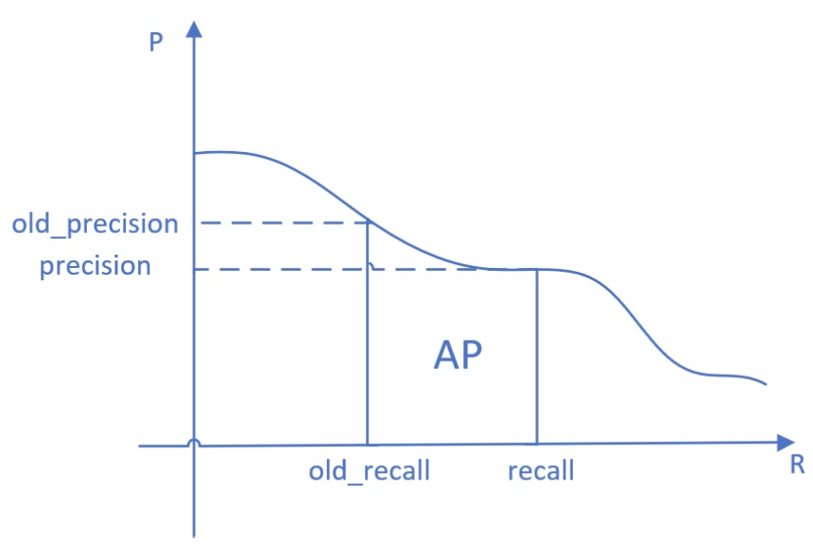
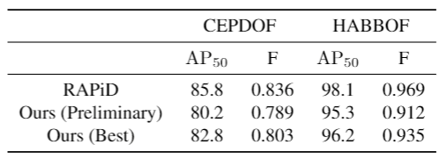
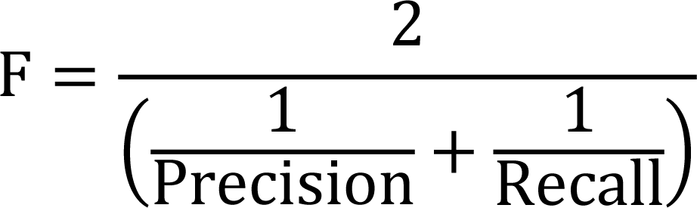
5.1.3 Quantitative Result
Average Precision (AP) at IoU = 0.5 (AP₅₀)
F-measure at a fixed 0.3 confidence threshold
Notes:
In terms of quantitative results, we have already discussed in the preliminary presentation that the metrics we used are AP at IoU = 0.5 and F-measure at fixed 0.3 confidence threshold.
The best configuration determined in previous slide shows moderate improvement on the detector’s performance in comparison to the preliminary setup, making our detector’s performance closer to the benchmark.

Slide 25
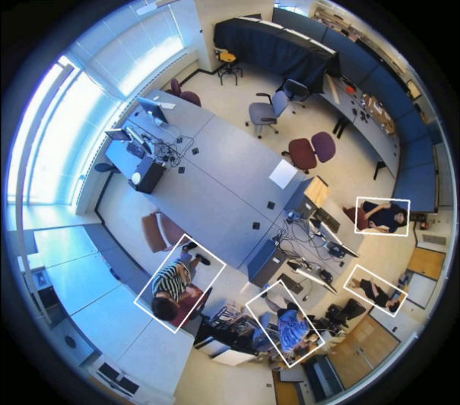
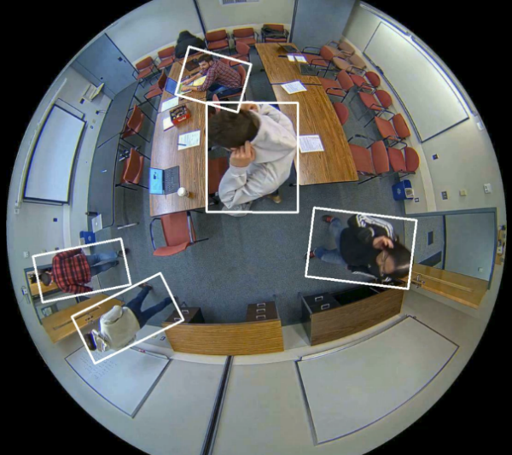
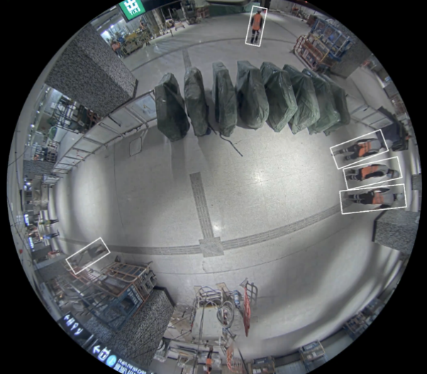
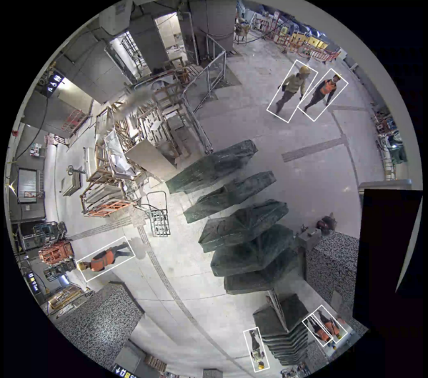
5.1.4 Qualitative Result
Notes:
In terms of Qualitative results, the performances empirically show no big difference between our preliminary and the best configuration setups. And similar as in preliminary presentation, some of best illustrative frames are shown here for your reference.

Slide 26
5.2.1 Binary Image Classifier - Preliminary
EfficientNetV2 architecture implementation ~80%
Training and Fine-tuning process
Limited resources 0%
Notes:
So about the Binary Image Classifier component, preliminarily, we partially finish implementing EfficientNetV2 but hasn’t started training yet.

Slide 27


5.2.2 Binary Image Classifier - Final
$$✓$$
EfficientNetV2 architecture implementation
Training and Fine-tuning process
Hyperparameters | Tuning Values
Learning Rate | 1.e-4, 1.e-3
Momentum | 0.9, 0.95
Weight Decay | 5.e-4, 5.e-3
Batch Size | 8, 16, 32
$$✓$$
Resize
Normalize
Convert to tensor
Vertical and
Horizontal Flip
Brightness and
Contrast Adjustment
Colour Jitter
SGD Optimizer
learning rate = 1.e-3
momentum = 0.9
weight decay = 5.e-4
70:30 Train:Val Split
Training Hyperparameters
batch size = 32
epoch ~ 120
≈ 100000 iterations
Fisheye Distortion
Notes:
Up to this point, the architecture implementation of our binary classifier is completed as well as its training and inference code, wrapping up the pipeline of our AI monitor. In terms of data preprocessing, recognizing the effectiveness of holdout cross-validation process in preventing overfitting problem and improving generalizability, we also randomly split both the helmet and jacket datasets into their corresponding training set and validation set with ratio 70:30. Various augmentation methods that we used ranging from the simple ones such as resize or normalization to the complex ones like vertical and horizontal flip or color jitter to apply onto the images before being fed into the training processes. Specifically, we also try to apply fisheye distortion on crawled standard images before training to examine its effectiveness on counteracting the out-domain issue. Similar to the detector’s, the classifiers’ weights are updated by using Stochastic Gradient Descent (SGD) optimizer. Together with the batch size value of 32, optimizer’s parameters are also selected to be: learning rate 0.001, momentum 0.9, and weight decay 0.0005, based on hyperparameters tuning process. For each safety equipment, we let the training process go for 120 epochs that is approximately 100000 feedforward iterations.

Slide 28
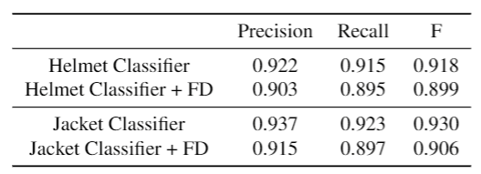
5.2.3 Quantitative Result
Notes:
In terms of quantitative results, we used the best checkpoints to load into our classifiers to make inferences and the metric that we used to evaluate our loaded classifiers’ performances is by calculating Precision, Recall and F-measure.
Note that FD here means Fisheye Distortion
As you can see, our classifiers for classifying wearing helmet and wearing jacket both have sufficiently high performance that reach our expectation. One point that worth mentioning here is that the performances unexpectedly drop when applying fisheye effect on standard instance. We suspect that the effect is not properly applied, say maybe standard frames are overly distorted. In fact, at construction site, workers are normally several meters distant from the vertical projection of cameras in the ground, making their images in fisheye frame more or less the same as in standard one. In future, we would focus on this aspect to improve our classifier.

Slide 29
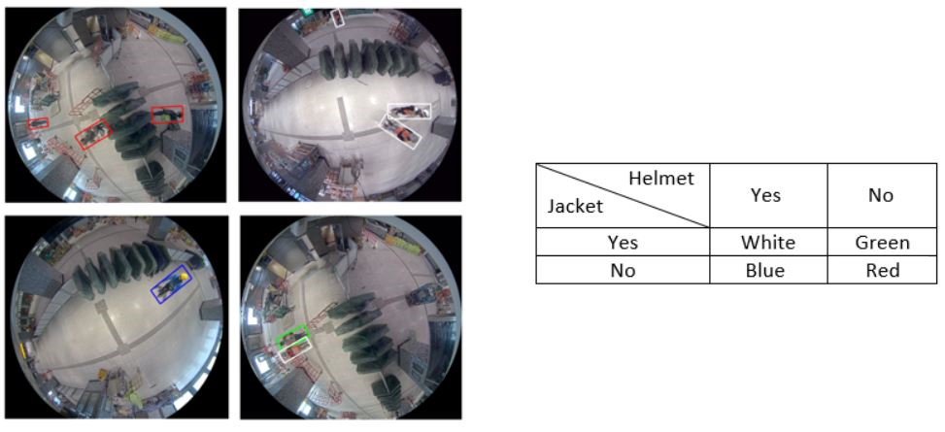
5.2.4 Qualitative Result
Notes:
In terms of Qualitative results, the performances empirically show no big difference between applying or not applying fisheye distortion in preprocessing process. And similar to the detector, some of best illustrative frames for classifiers performance are shown here for your reference.
Note that we define the color for each bounding box based on its according classification result as you can see in the table. I apologize that the images maybe a bit blurred but as you can see in the bottom left one, the worker inside only wear helmet while jacket is missing, so the color of the bounding box is displayed as blue.

Slide 30
6. Conclusion
Binary Image Classifier
Multi-Person Detector
Notes:
In this project, we proposed an autonomous AI super-visor to help monitor workers safety in construction sitesthrough fisheye imaging. The system consists of two main components, a multi-person detector and a pair of binary classifier instances. The detector, which is a replication of RAPiD model, holds responsible for locating and correspondingly extracting spatial information of every worker inside input frames. Subsequently, single-person images will be cropped out based on those information and be justified by the two classifier instances, which are powered by EfficientNetV2, if their according person is wearing safety helmet and safety jacket or not. The classification results will then be reflected respectively by the predefined color of the bounding boxes in the output frames. We believe that our AI monitor can be extended and applied into many more use cases not limited in construction safety area.

Slide 31
United Nations Environment Programme. 2020 Global Status Report for Buildings and Construction: Towards a Zero-emission, Efficient and Resilient Buildings and Construction Sector. Nairobi, 2020.
CPWR – The Center for Construction Research and Training. Data Bulletin: Fatal Injury Trends in the Construction Industry, 02 2021
T. Anojan and C. S. A. Siriwardana. A Study to Investigate the Factors Affecting Construction Worker Performance. In 2021 Moratuwa Engineering Research Conference (MERCon), pages 13–18, 2021.
Z. Duan, M. Ozan Tezcan, H. Nakamura, P. Ishwar, and J. Konrad. Rapid: Rotation-aware people detection in overhead fisheye images. In 2020 IEEE/CVF Conference on Computer Vision and Pattern Recognition Workshops (CVPRW), pages 2700–2709, 2020.
M. Tan and Q. V. Le. Efficientnetv2: Smaller models and faster training.ArXiv, abs/2104.00298, 2021
7 References

Slide 32
Thanks for Listening ! Q&A

